Slide 1
FOURTH QUARTILE
Designing for an Active and Purposeful Retirement Lifestyle
Adam Barry, Amy Chang, Ethan Hellman, Brendan McLoughlin
CS 147 · F23 · Stanford University

Slide 2
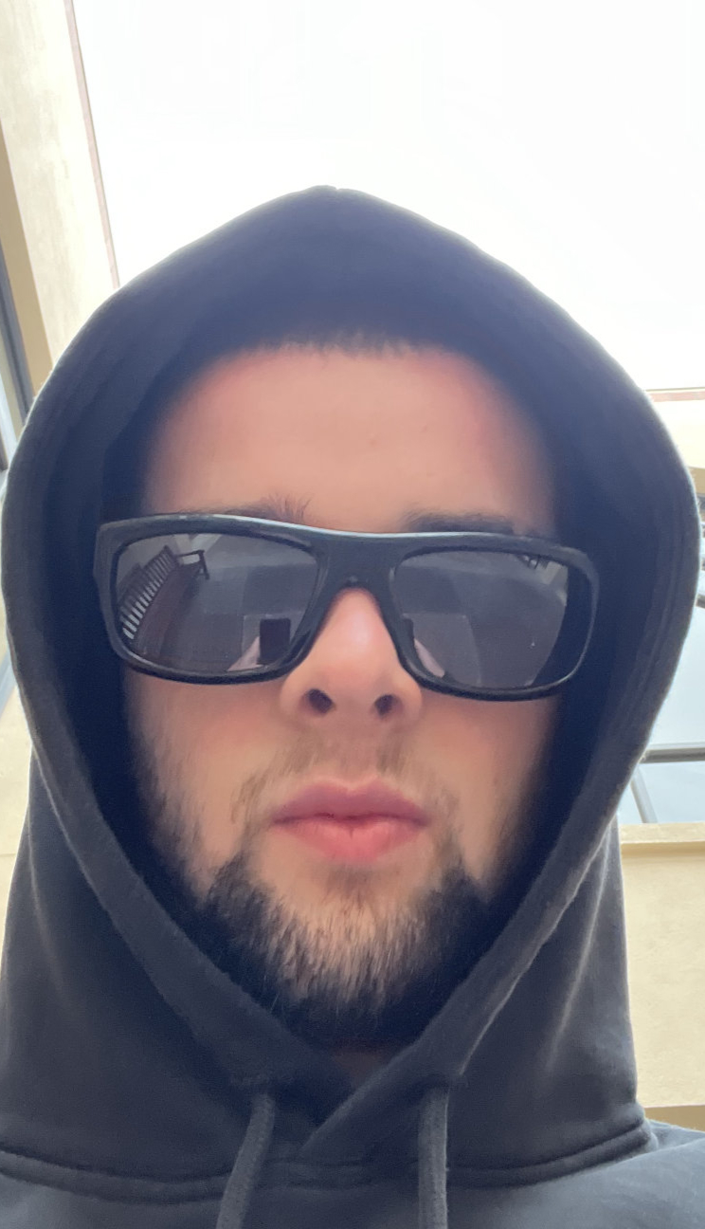
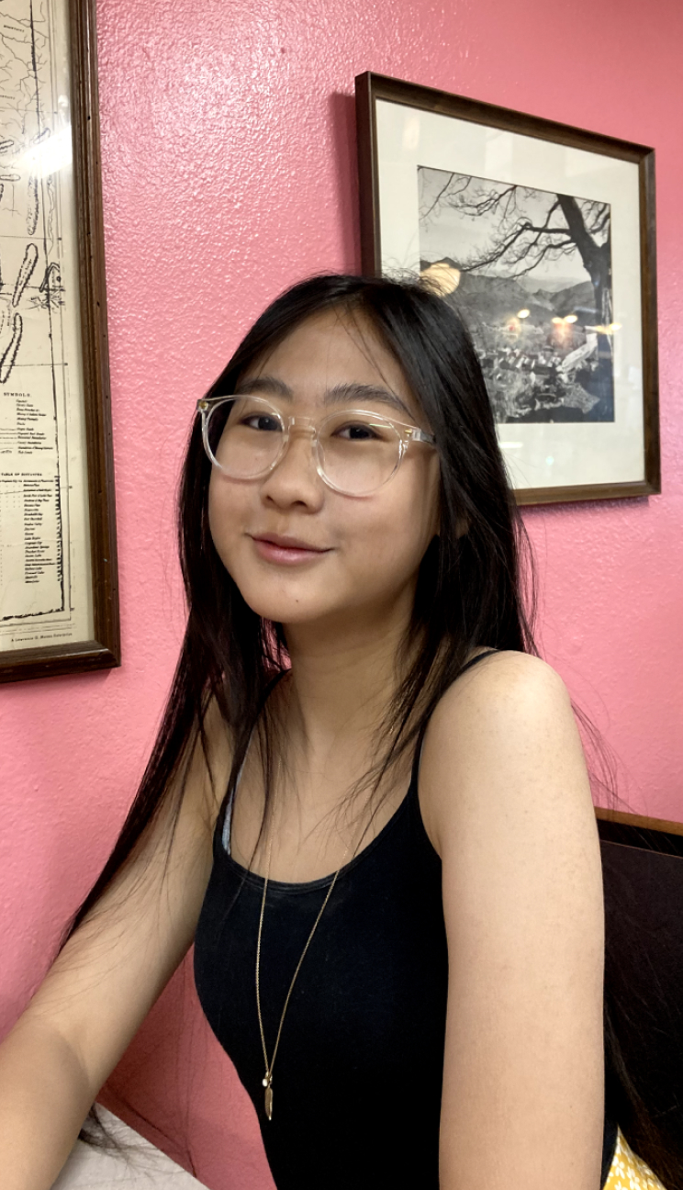
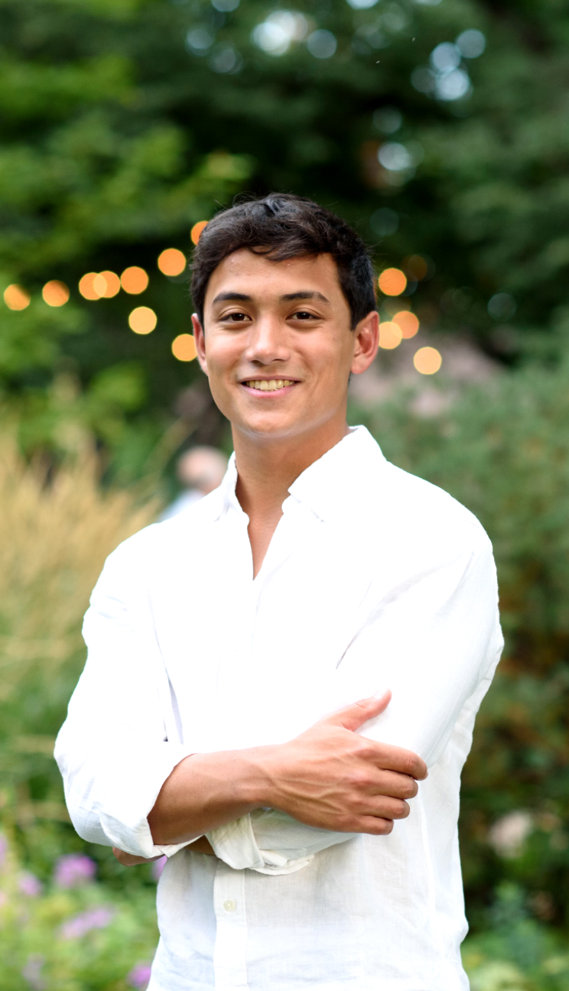
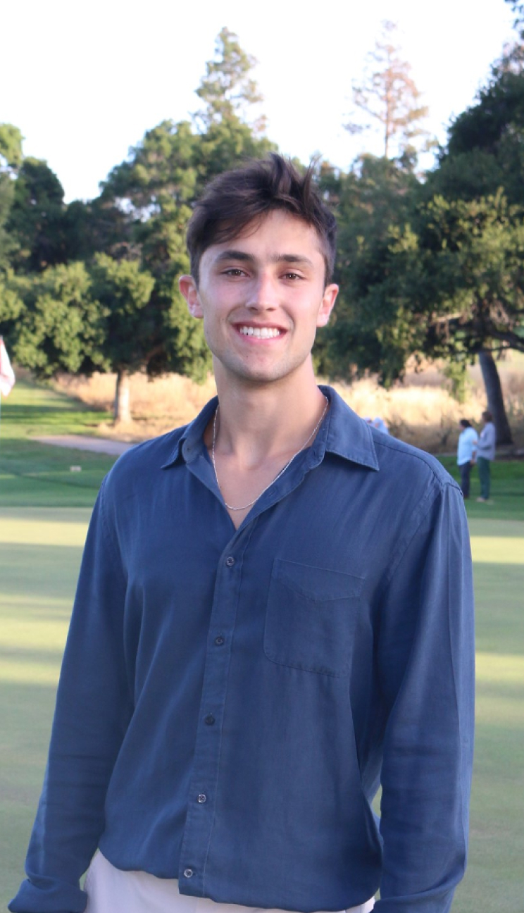
INTRO — TEAM
Name: Adam Barry Year: Junior Major: Computer Science (HCI)
Name: Amy Chang Year: Junior Major: Computer Science (HCI)
Name: Ethan Hellman Year: Senior Major: Computer Science (AI)
Name: Brendan McLoughlin Year: Senior Major: Computer Science (HCI)

Slide 3
Problem Domain
How can we encourage citizens of a retirement age to stay actively engaged with both their community and environment?

Slide 4
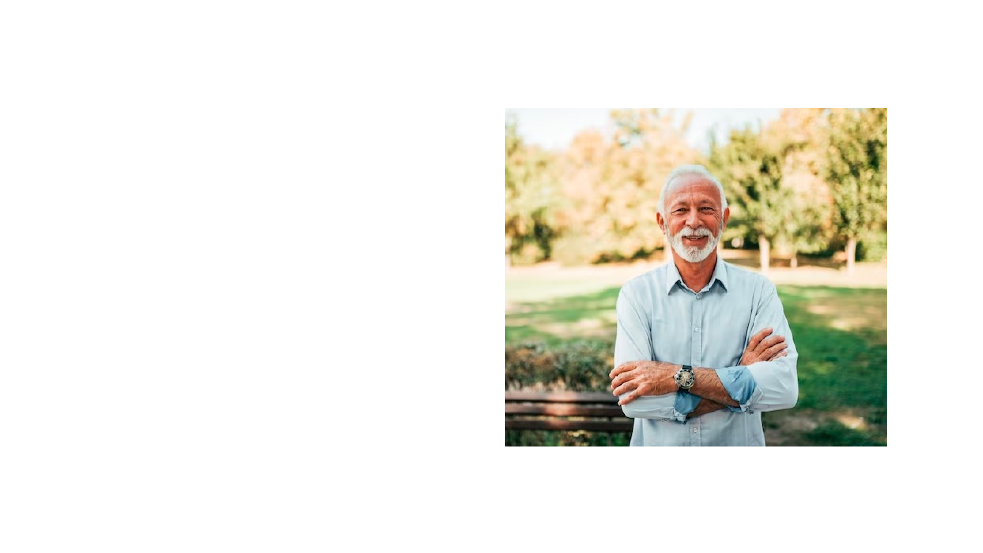
Bill
80 year old U.S. Army Veteran and former Mechanical Engineer. Enjoys photography and walking his dog.

Slide 5
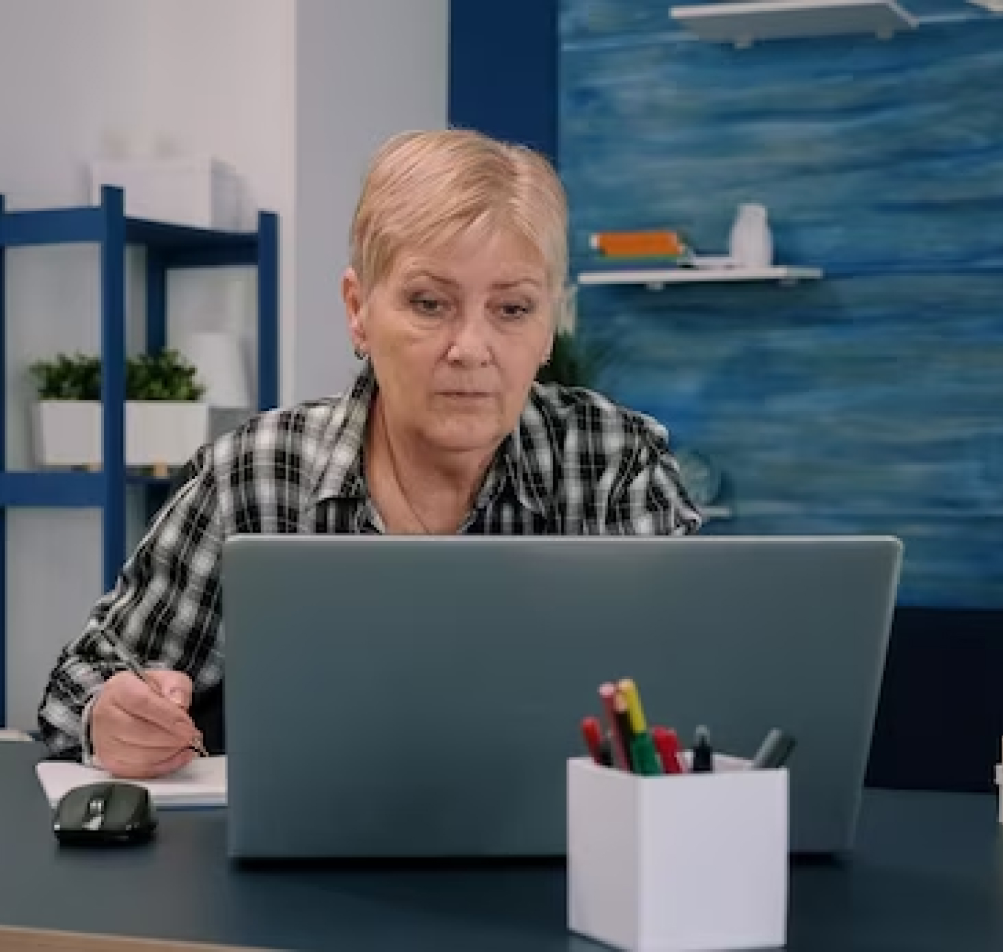
Anita
74 year-old AARP regional leader and front-desk assistant (and social linchpin) of Sequoia Homes Retirement Center in SF.

Slide 6
POV Development ‍
Mary-Lue, Robin, and Marie

Slide 7
Mary-Lue
We met: Mary-Lue Timpson, an 80-year-old retired school teacher who now volunteers at the front desk of the Senior Center in Palo Alto. We were surprised to learn: that Mary-Lue Timpson considers herself separate from the other seniors, verbally distinguishing herself by saying, “I’m not the usual type of person who comes in here.” We wonder if this means: she derives a meaningful sense of purpose from “having a role.” It would be game-changing if we: could deliver a similar sense of purpose through responsibility to more people.

Slide 8
Mary-Lue
We met: Mary-Lue Timpson, an 80-year-old retired school teacher who now volunteers at the front desk of the Senior Center in Palo Alto. We were surprised to learn: that Mary-Lue Timpson considers herself separate from the other seniors, verbally distinguishing herself by saying, “I’m not the usual type of person who comes in here.” We wonder if this means: she considers herself different from other seniors because of her clear role in the community which gives her a greater sense of purpose. It would be game-changing if we: could deliver a similar sense of purpose through responsibility to more people.

Slide 9
How might we: expand opportunities for senior citizens to get involved and feel purposeful within their local community?

Slide 10
Robin
We met: Robin an inactive and 62-year-old woman with no friends who recently experienced multiple `losses during COVID We were surprised to learn: she feels content despite her loneliness because her main form of social interaction is with her pets (a turtle, a possum, and a dog) We wonder if this means: Non-human social interaction helps prevent loneliness in elderly adults It would be game-changing if we: could help elderly people who lost their loved ones cope with loneliness via non-human social interaction

Slide 11
Robin
We met: Robin an inactive and 62-year-old woman with no friends who recently experienced multiple losses during COVID We were surprised to learn: Robin makes little to no effort to seek out human interaction. Instead she spends her days caring for her pets and seems content in doing so. We wonder if this means: Non-human social interaction is preferable to new human connections for those who have experienced loss. It would be game-changing if we: could connect elderly people who have or may soon experience loss with non-human companions.›

Slide 12
️
How might we: ensure every senior always has someone… or something… to talk to whenever they need?

Slide 13
Marie
We met: Marie: a 76-year-old former Stanford researcher who lives a very physically and socially active retirement lifestyle We were surprised to learn: that all of her friends also have active and social lifestyles We wonder if this means: her friend group serves as a community that keeps her accountable and motivated to stay active and healthy It would be game-changing if we: could ensure that all retirees have supportive communities that facilitate and encourage healthy lifestyles

Slide 14
Robin
We met: Robin an inactive and 62-year-old woman with no friends who recently experienced multiple losses during COVID We were surprised to learn: though Robin knew the importance of being active, she refused to even entertain the idea of joining nearby senior activity classes We wonder if this means: Robin feels unwelcome in existing senior activity communities. It would be game-changing if we: could create low stakes environments for seniors to enter supportive communities that facilitate and encourage healthy lifestyles.

Slide 15
How might we: encourage elderly people to play a sport that is geared towards those with less physical mobility?

Slide 16
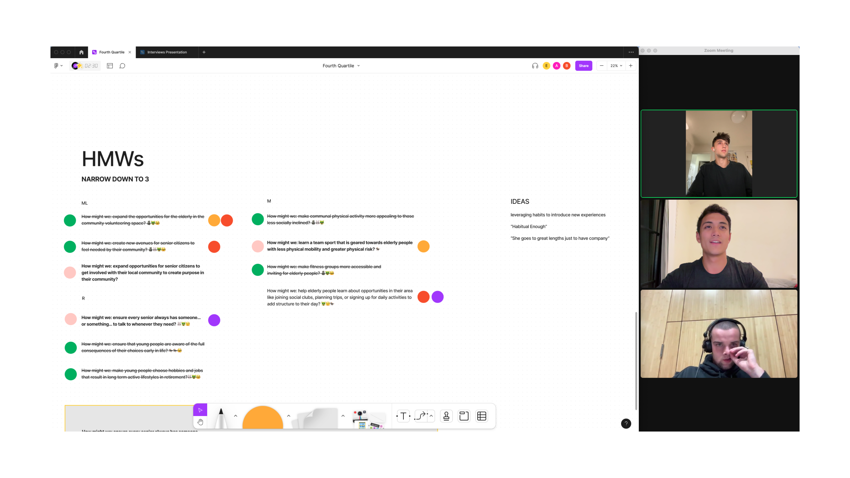

Slide 17
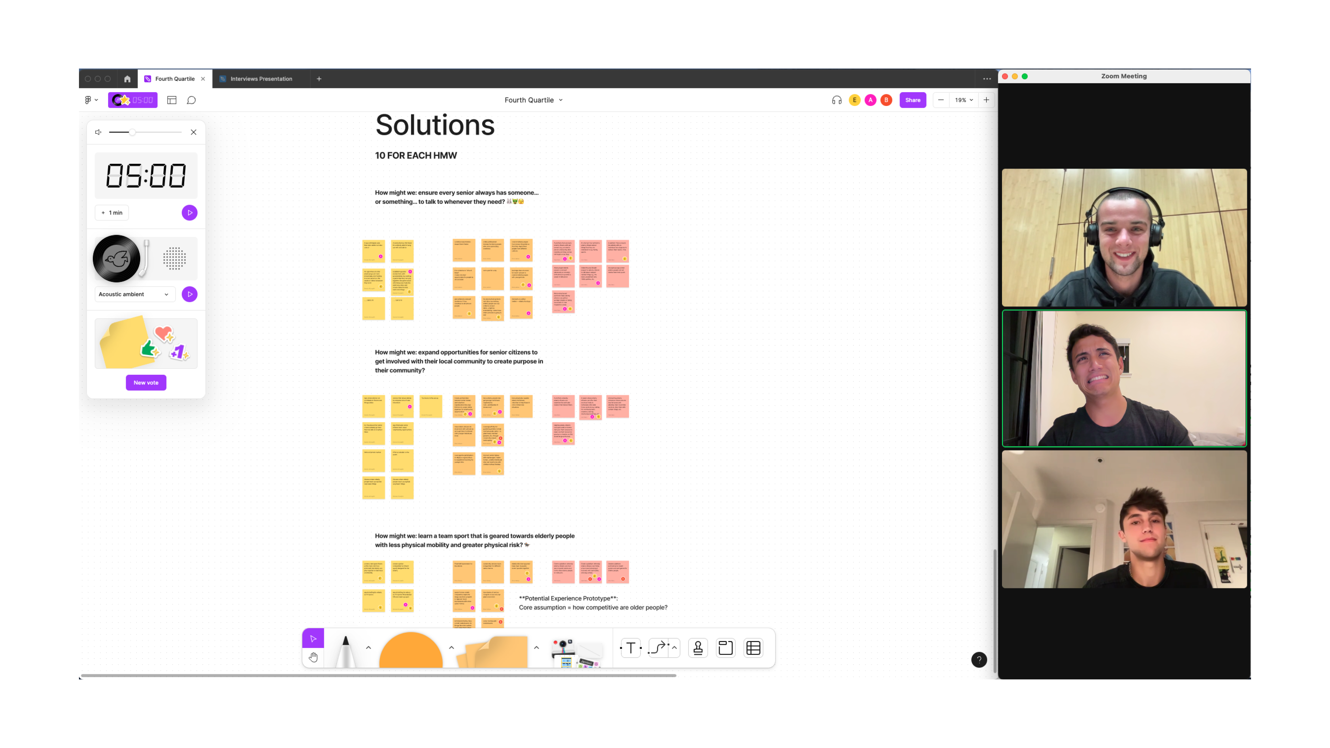

Slide 18
Solutions ✅
Gardening, children’s sports, and book clubs

Slide 19
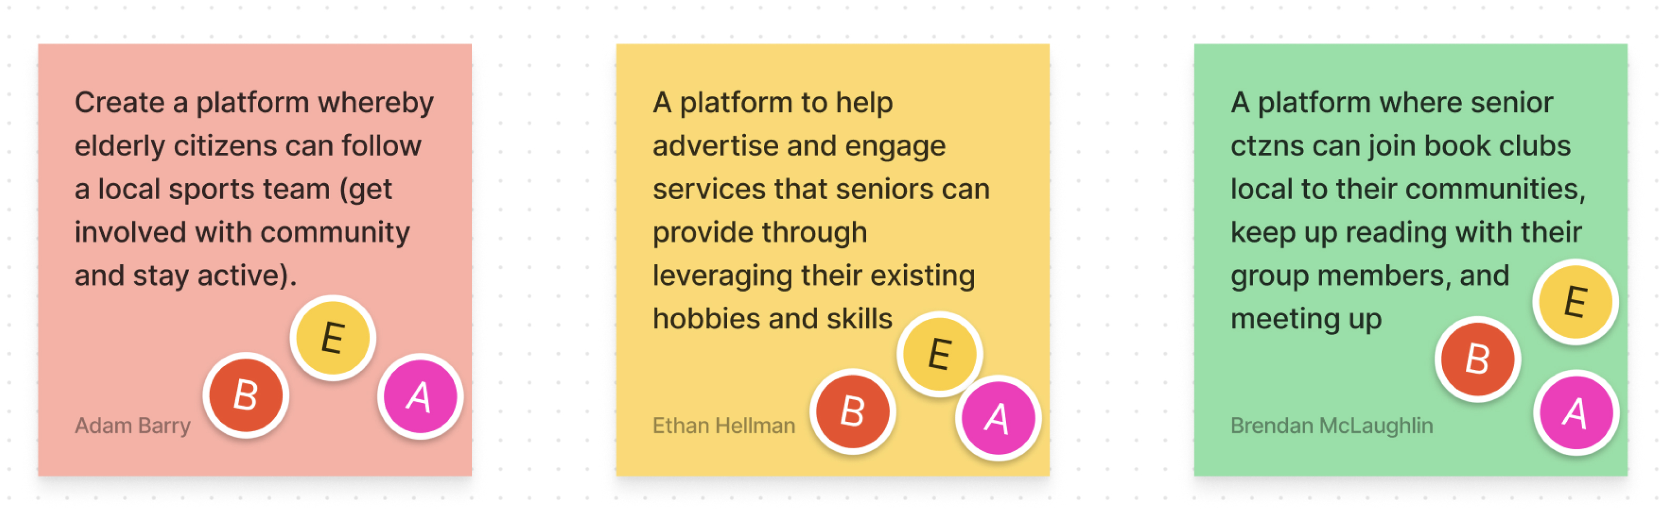

Slide 20
Experience Prototypes

Slide 21
Experience Prototype #1
Community Gardening

Slide 22
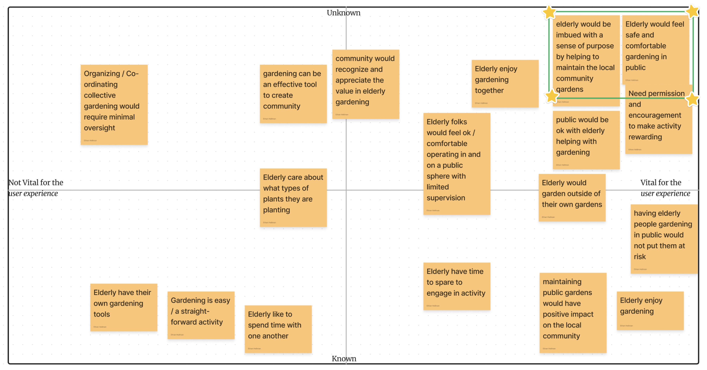

Slide 23

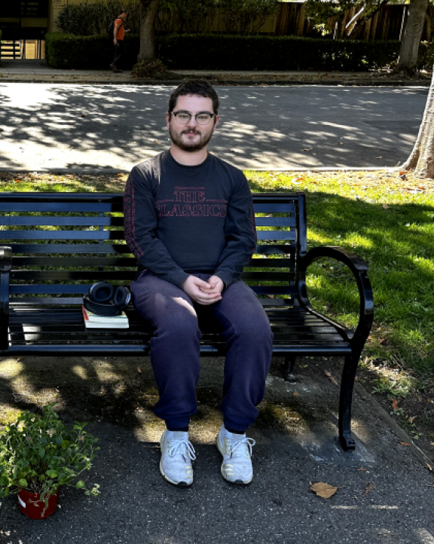
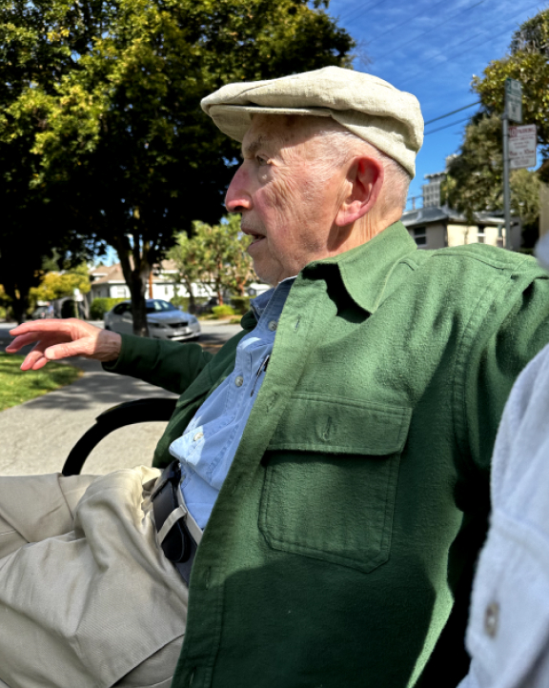
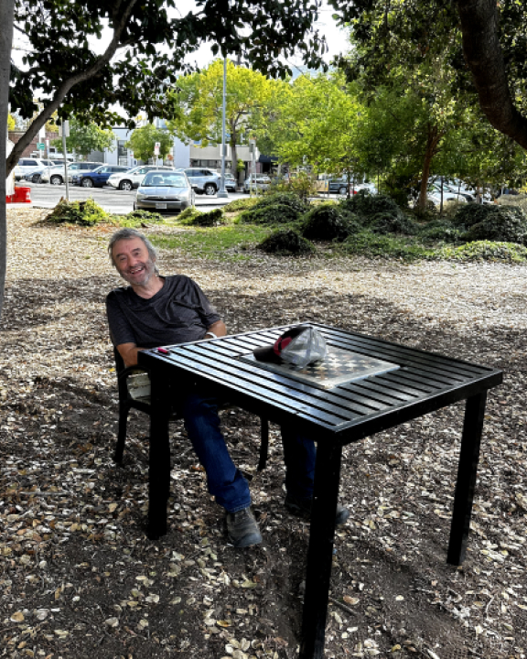
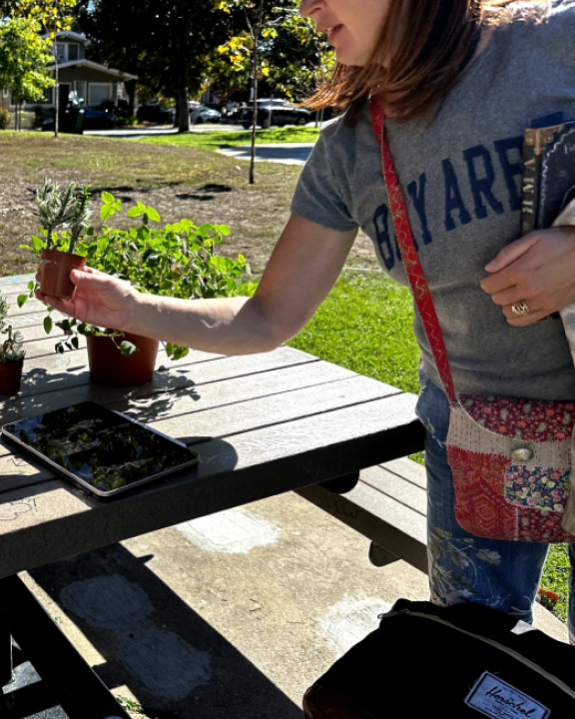
User Experiences ⚒️
Critical assumption tested People feel comfortable gardening in public. Participant 4 strangers at the park. Diversity in sex, age (25 - 96!), and experience with gardening. Experience prototype Gave participants a free plant and a spade and told them that they could plant it wherever they wanted.
Leo
Roy
Thomas
Kamilla

Slide 24
Results
What Worked?
What Didn’t Work?
Users responded positively to the idea of gardening, one planted. Elucidated a sense of community and responsibility...“I will come back every day and water it!” Highlighted service as a means of fulfillment. Heard many stories!
Participants hesitant to plant in public, concerned about permission. Appeared as frivolous activity given no one would take care thereafter. Wanted clarity on connection to coursework. Some did not feel “qualified” to garden.

Slide 25
Experience Prototype #2
Local Youth Sports Teams

Slide 26
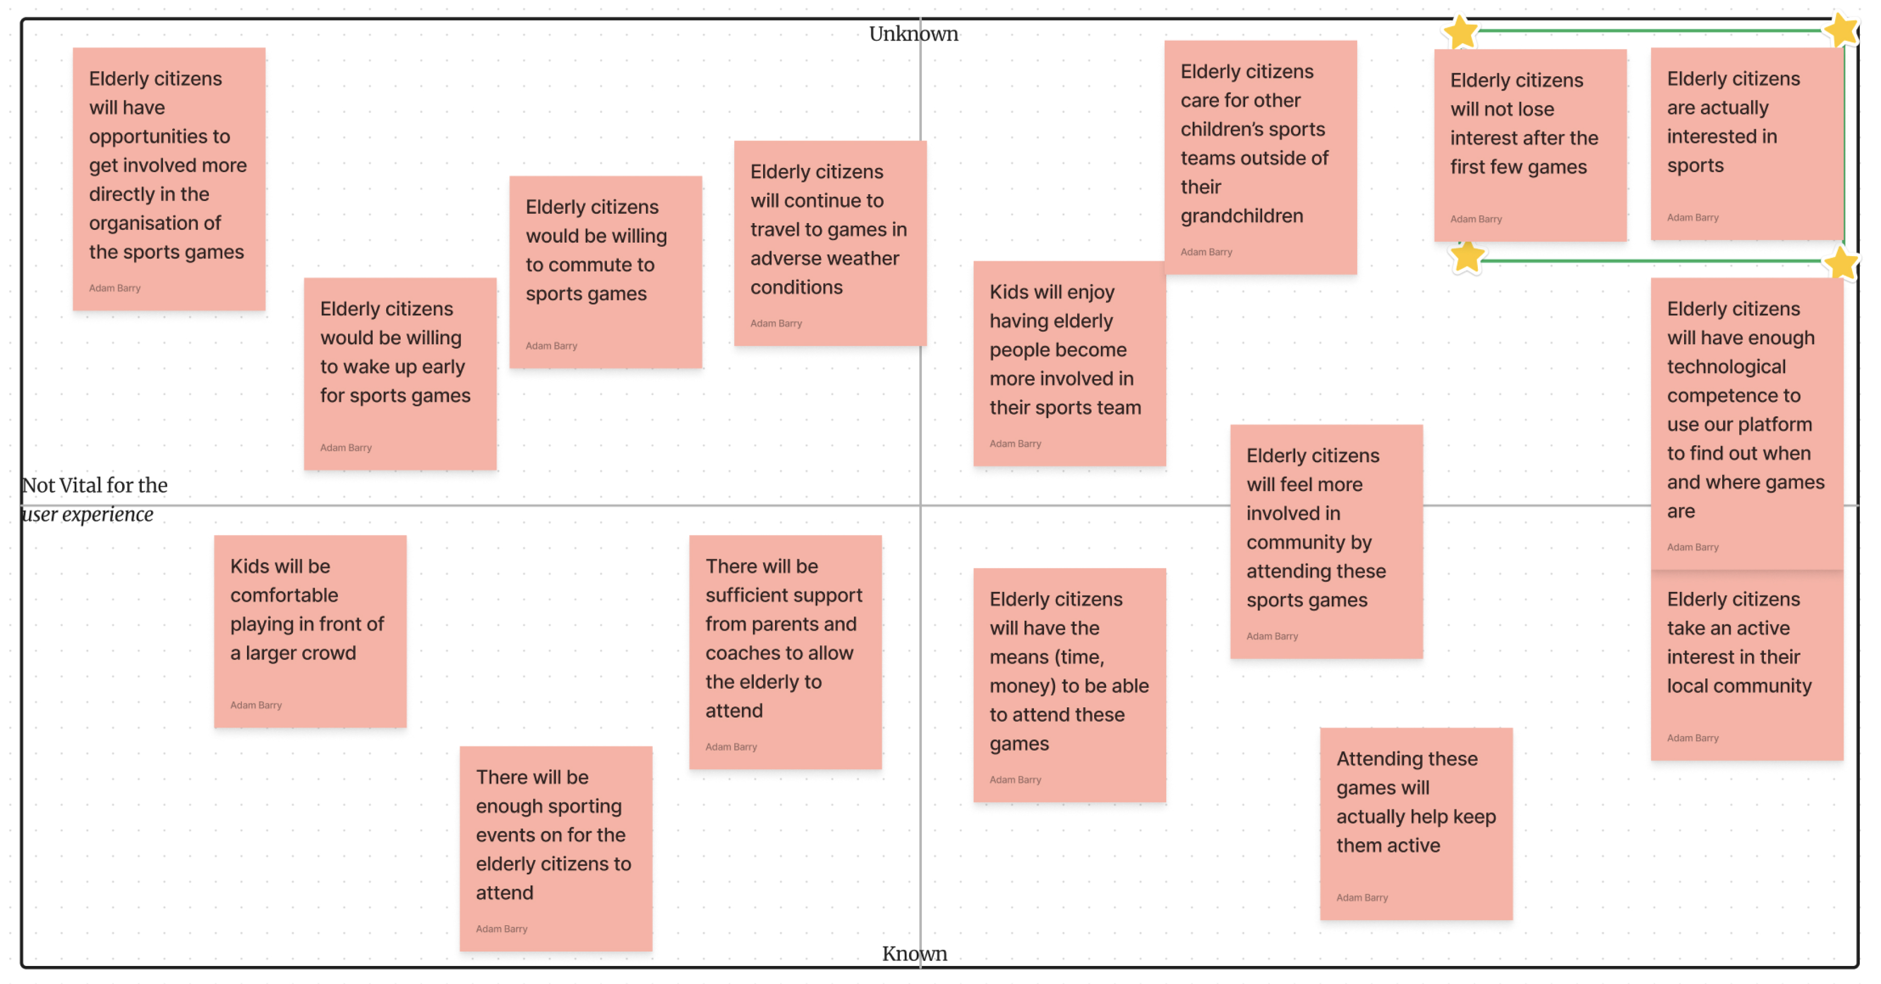

Slide 27
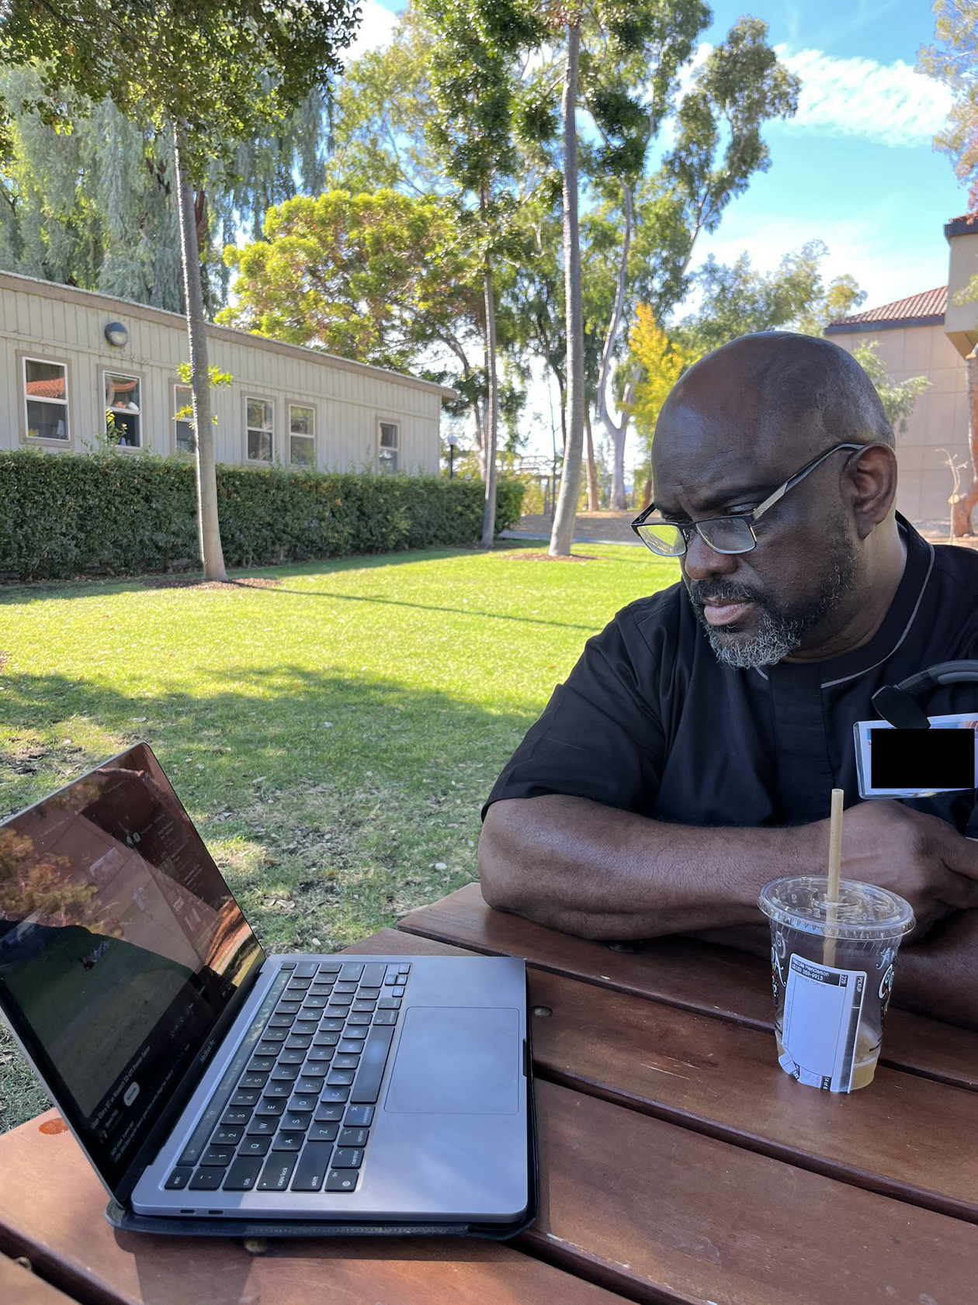
User Experience ⚒️
Critical assumption tested elderly citizens are interested in sports Participant a retired male who was previously an educator, assistant superintendent of a high school, and a track coach Experience prototype we showed the man a YouTube video of a youth soccer team playing a match against another team to see how he would engage with both the sport and the level at which it was played at

Slide 28
Results
What Worked?
What Didn’t Work?
User responded well to the video Would gladly follow a local youth sports team While an educator, highlighted groups attempting to create a community that would attend and support local high school teams
User wouldn’t necessarily get involved with the management or organisation of a team Involvement would be support only

Slide 29
Experience Prototype #3
Book Clubs

Slide 30
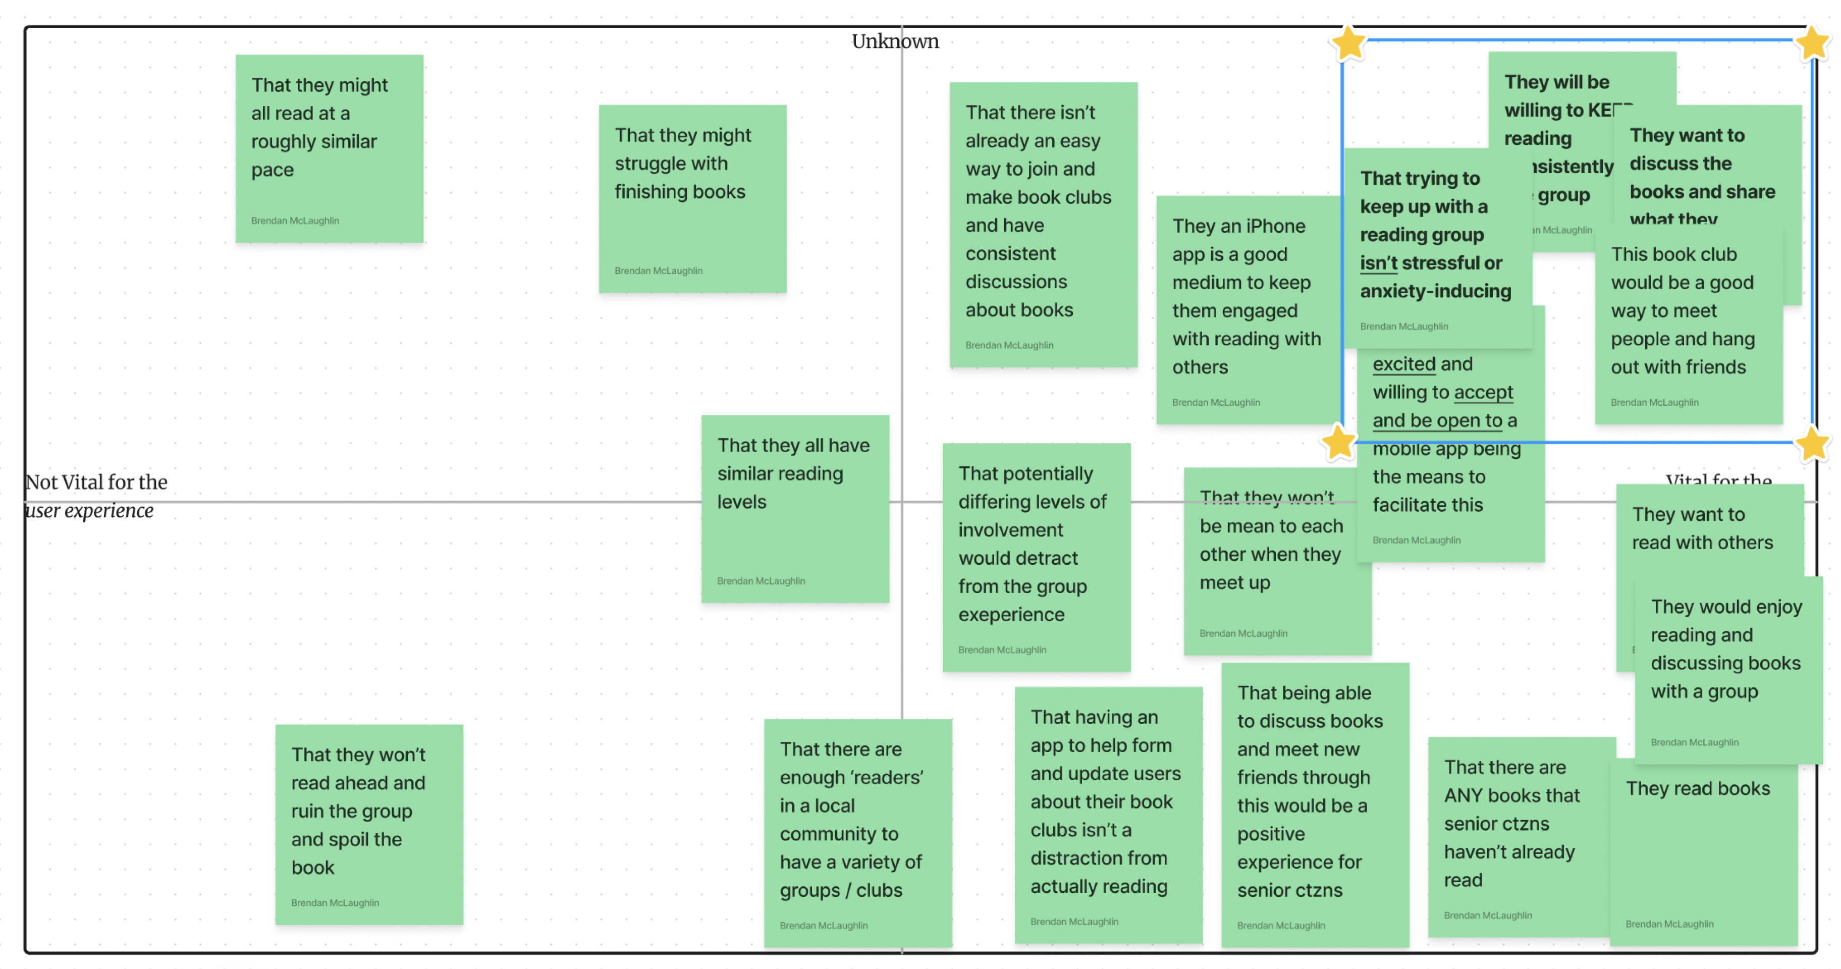

Slide 31
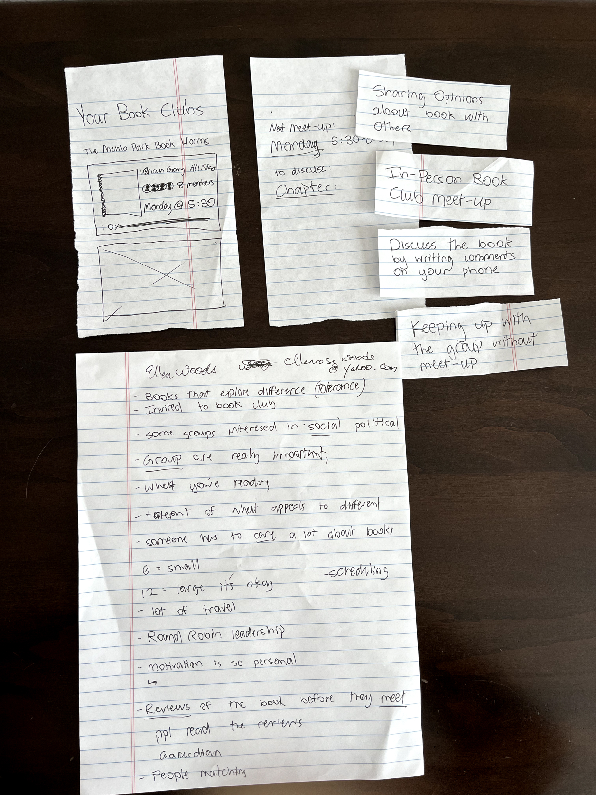
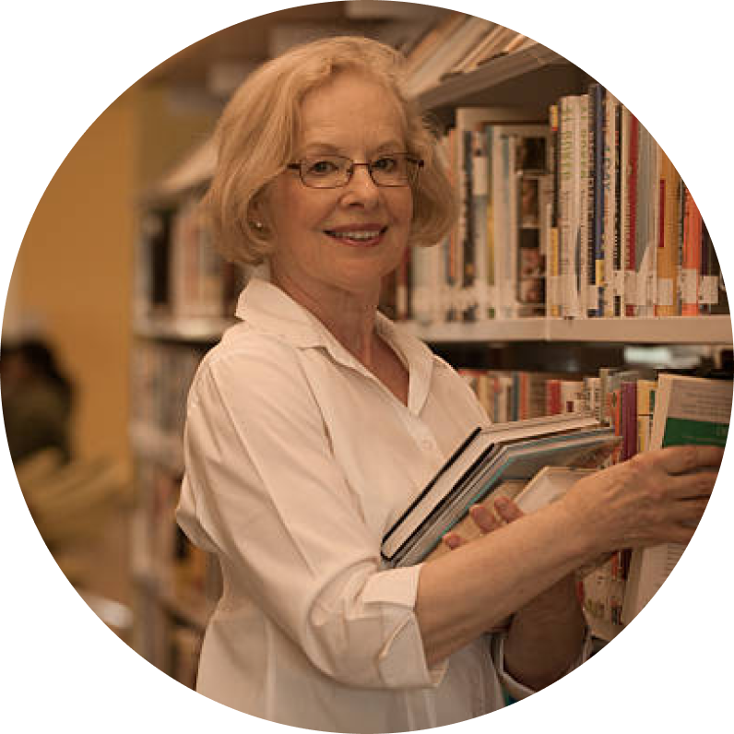
User Experience ⚒️
Critical assumptions tested Elderly adults are excited about discussing the books with peers Need for mobile app? Participant A recently retired Stanford Associate Vice Provost who is involved in multiple book clubs Experience prototype Approach elderly adult in library and ask what book they’re reading Fill in paper prototype screens with book name Simulate reaction to joining book club group

Slide 32
Results
What Worked?
What Didn’t Work?
Elicited strong positive emotions towards book clubs UI made participant reveal that the actual group is more important than the book Prototype prompted participant to share key insights about book club
Participant spoke more than she did interact with prototype due to prior book club involvement

Slide 33
What’s Next? ✏️
Solution
Ethics
Audience
Gardening!
Legal implications Recruiting and assisting a diverse popultation
Audience is both urban and suburban of varying levels of physical ability Unsure of whether to expand out from elderly people just yet

Slide 34
Appendix

Slide 35
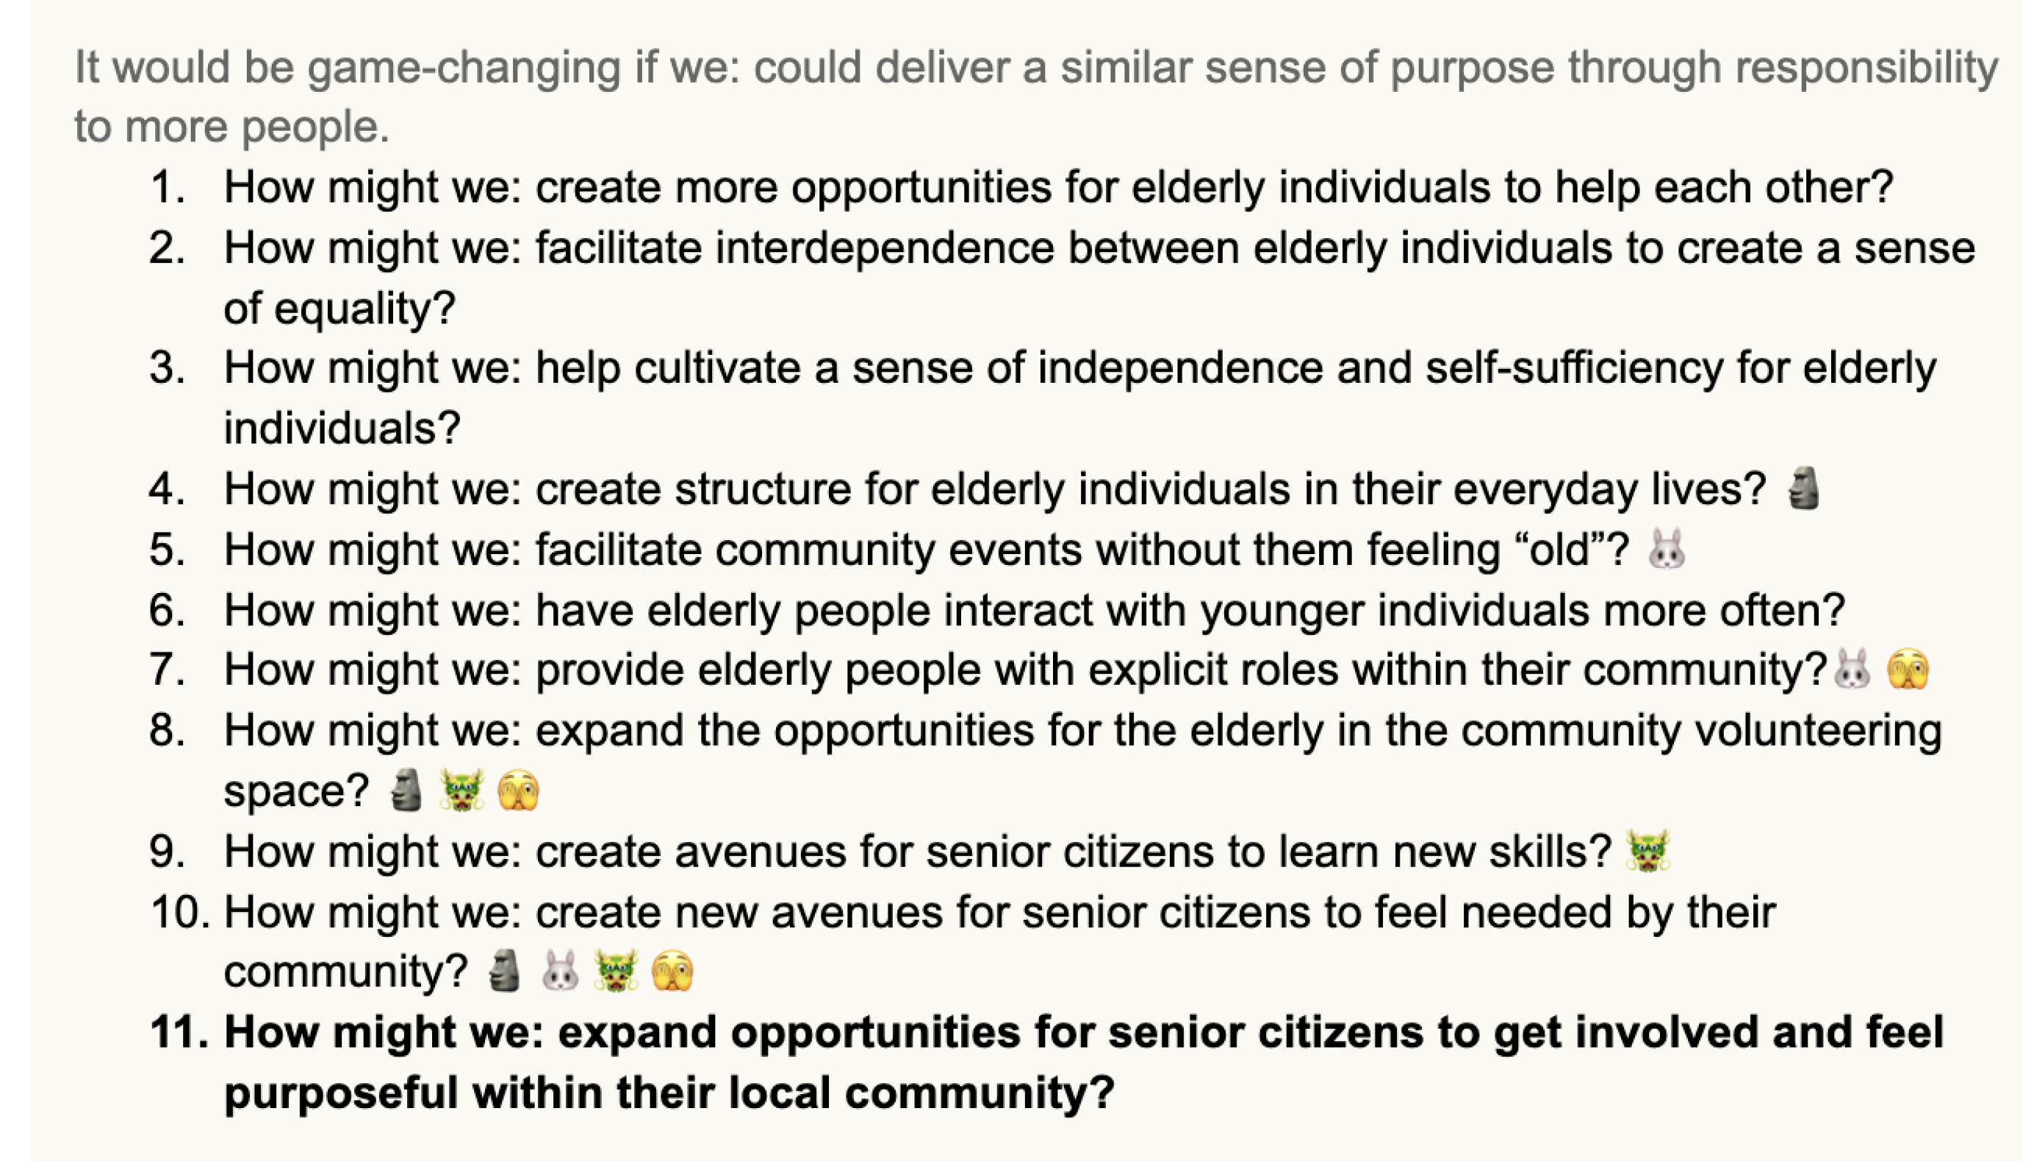
Mary-Lue

Slide 36
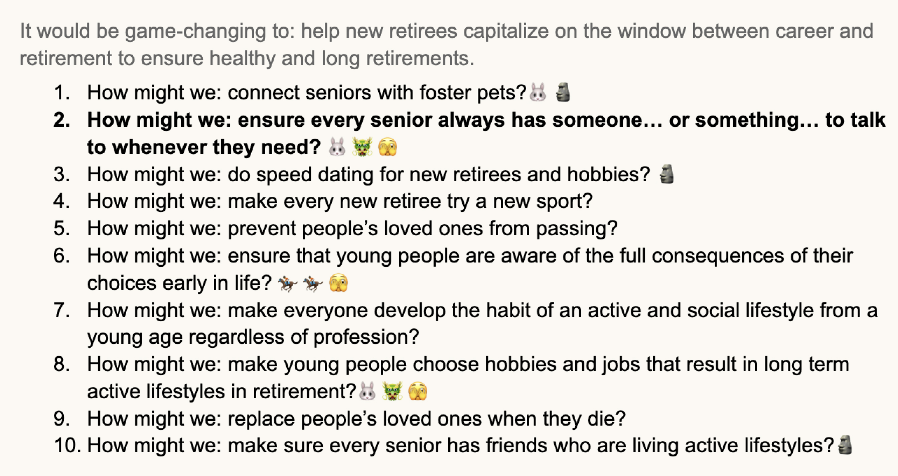
Robin

Slide 37
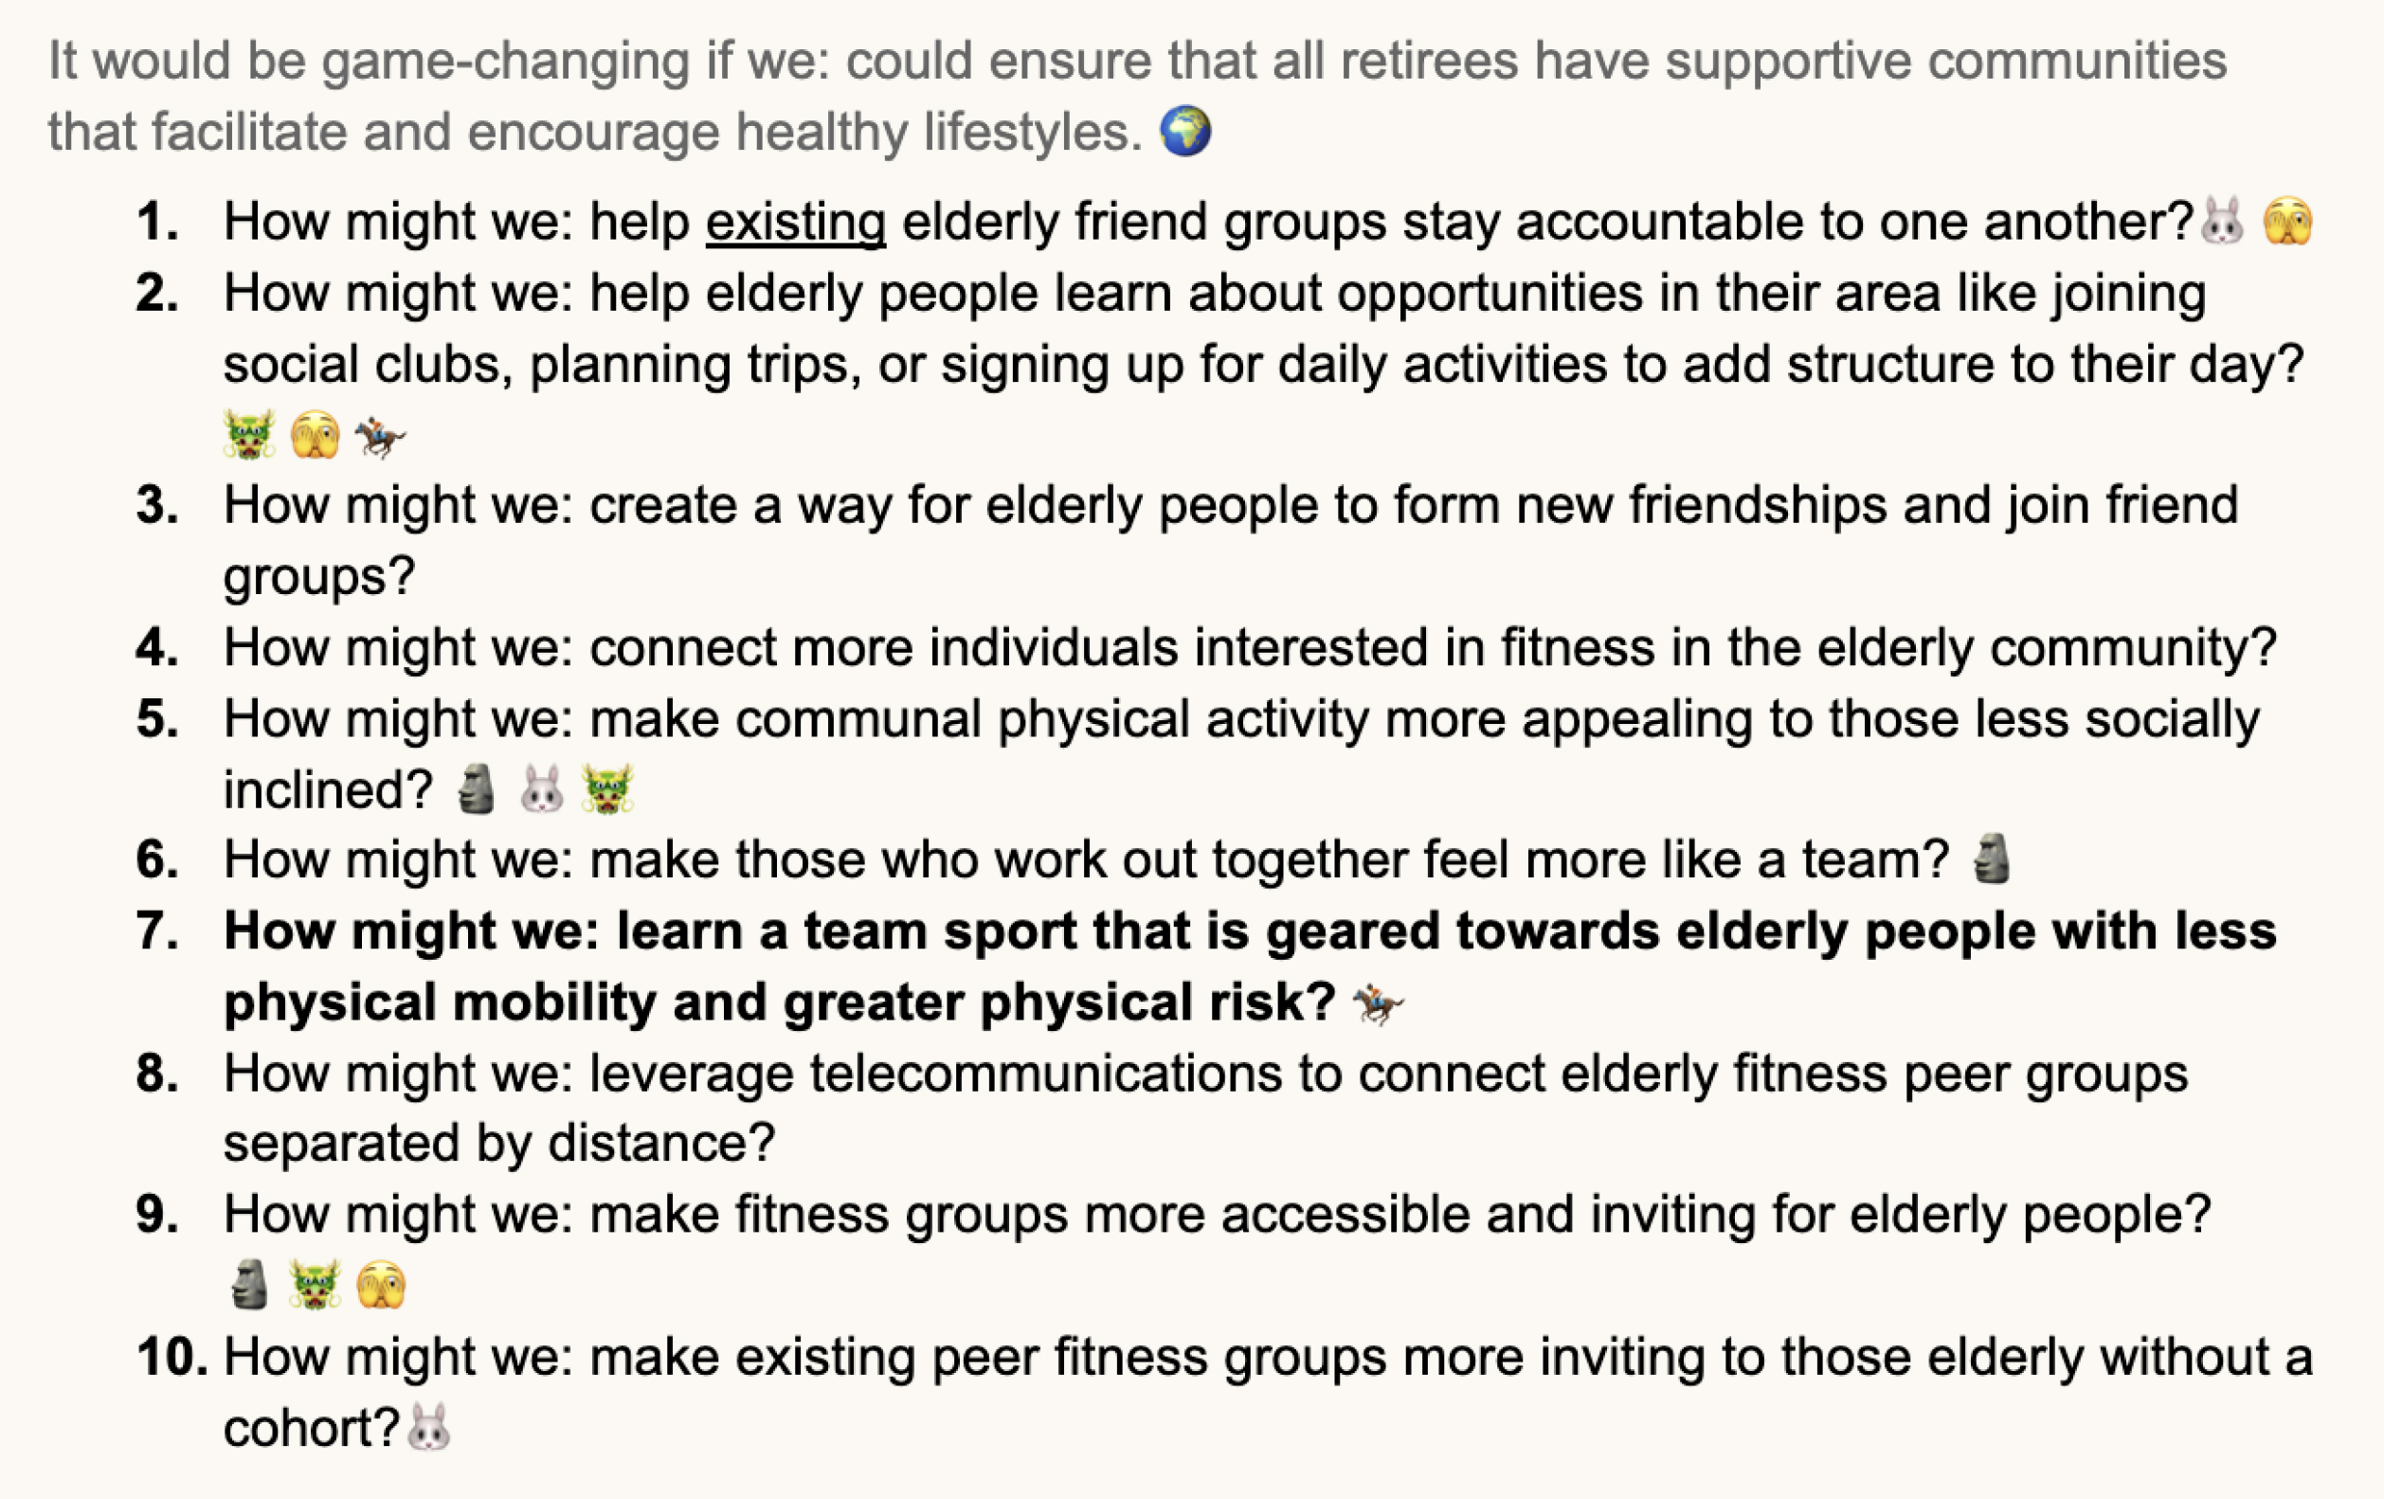
Marie

Slide 38
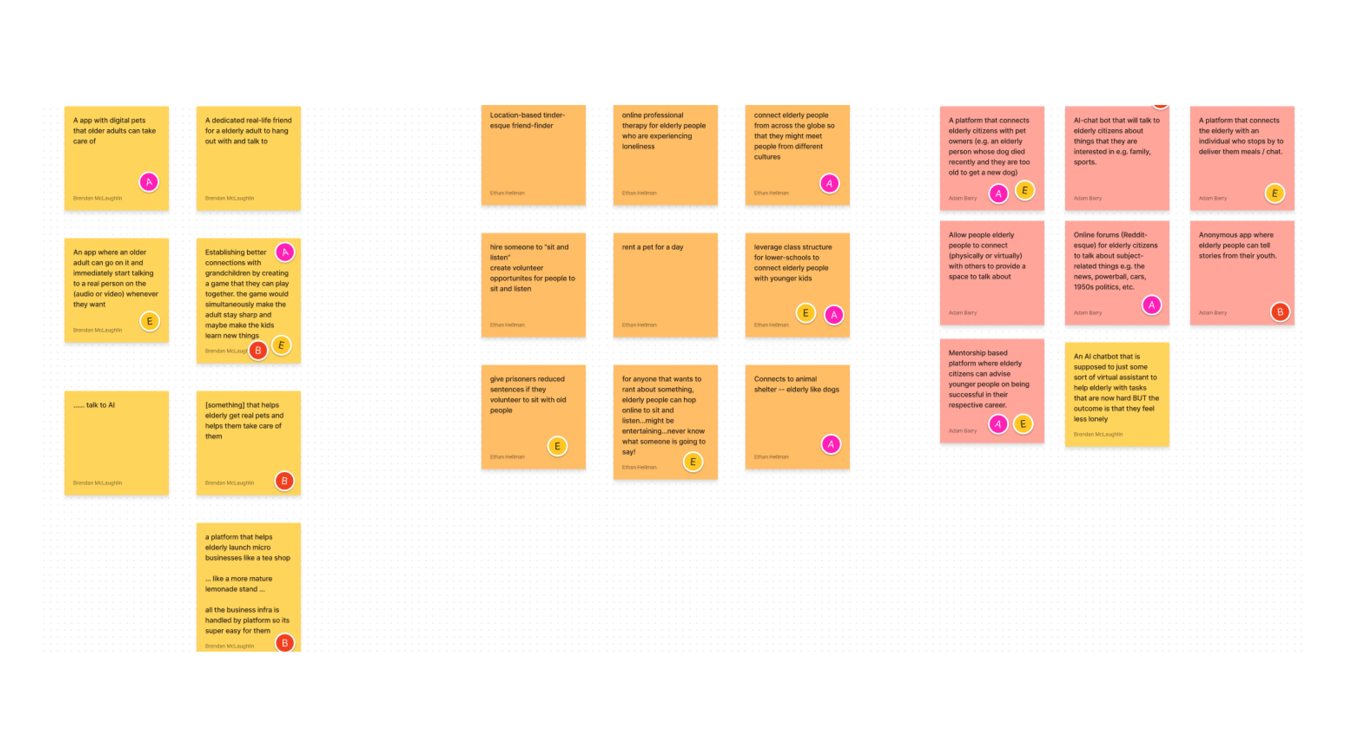

Slide 39
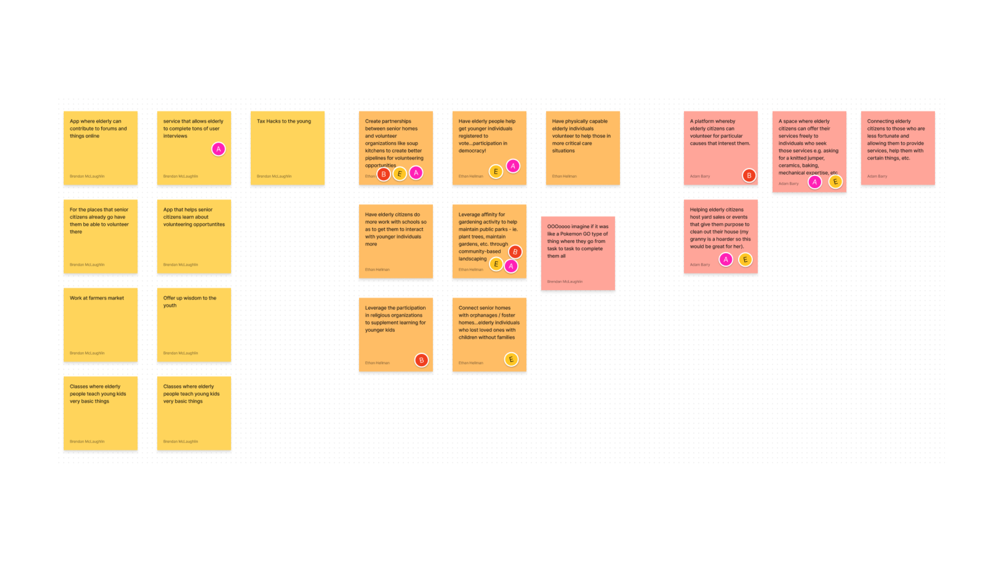

Slide 40
